Slide 1

Song Genre
Classification Model
Machine Learning and Predictive Analysis
05/25/2023
Scott Matsubara

Slide 2






Group 2
Our Teams
Agenda
Problem
Statement
Our Team
Our Data
Data Exploration
Methodology
Conclusions
Devdutt Sharma
Scott Matsubara
Sanket Mayekar
Taylor Furry
Yi Chin Tzou

Slide 3


Group 2
Our Team
Agenda
Problem
Statement
Agenda
Out Data
Data Exploration
#
Title
Methodology
Conclusions
1
Problem statement
00:00
2
Our Data
01:00
3
Data Exploration
02:00
4
Methodology
05:00
5
Conclusions
13:00

Slide 4


Group 2
Our Team
Agenda
Problem
Statement
Problem Statement
Our Data
Data Exploration
Methodology
The goal of our team is to analyze, build and improve the Spotify’s recommendation system in order to increase customer satisfaction, retention, and time spent on the platform broadly.
Using different algorithms such as popularity based, Content-Based Filtering and K-Nearest Neighbors to build a recommendation engine that can suggest songs to the user based on their listening history and preferences.
Conclusions

Slide 5

Group 2
Our Data
Our Team
Agenda
Problem
Statement
Variable | Data Type
track_id | String
artists | String
album_name | String
track_name | String
explicit | Categorical
key | Categorical
mode | Categorical
time_signature | Categorical
track_genre | Categorical
Variable | Data Type
popularity | Numeric
duration_ms | Numeric
danceability | Numeric
energy | Numeric
loudness | Numeric
speechiness | Numeric
acousticness | Numeric
instrumentalness | Numeric
liveness | Numeric
valence | Numeric
tempo | Numeric
Our Data
Data Exploration
Methodology
Conclusions

Slide 6



Group 2
Data Pre-Processing
Our Team
Agenda
Problem
Statement
Removals
Unnecessary columns such as mode, key, and time signature
Children’s songs Genre
Duplicate track names
Changes
Scaled numeric features
Created combined genre column
Added dummy variables for genre
Our Data
Data Exploration
Methodology
Conclusions

Slide 7


Group 2
Data Limitations
Our Team
Agenda
Problem
Statement
Limited data set (About 90,000 songs)
Some genres were not included entirely in our dataset (ex. Bollywood)
No user or feedback ratings
Had to use 2 different data sets
Not all English makes NLP problematic
Our Data
Data Exploration
Methodology
Conclusions

Slide 8
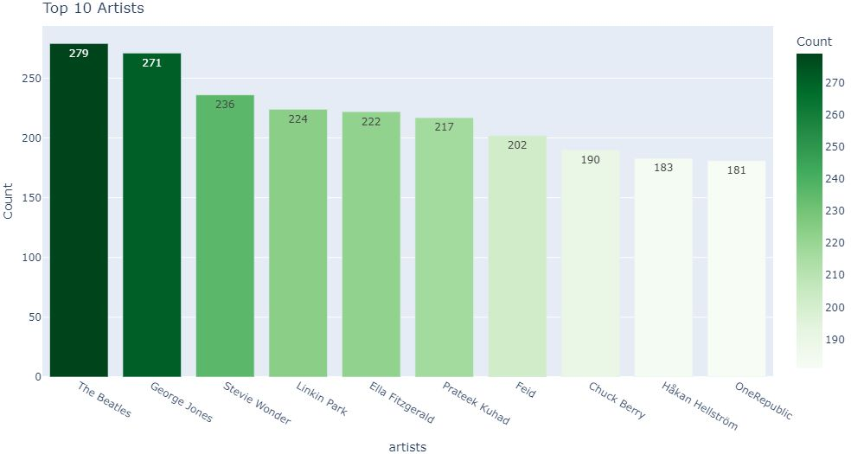
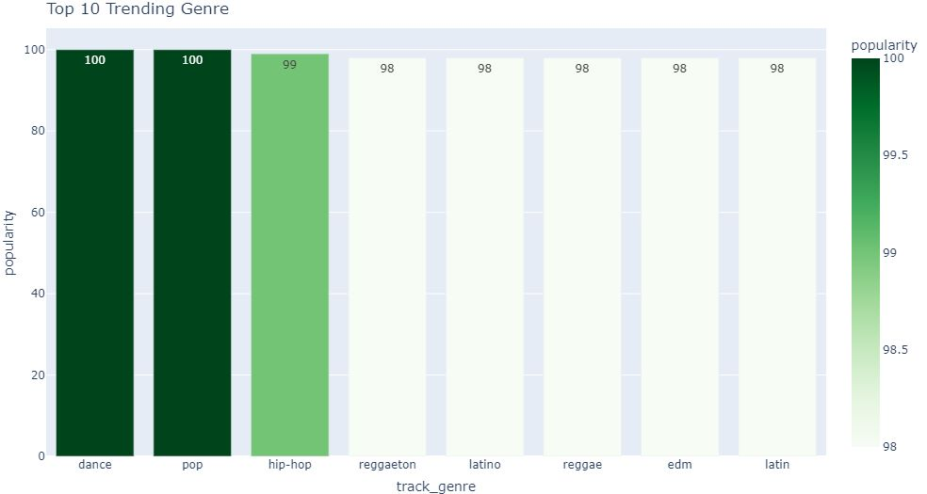
Group 2
Data Exploration
Our Team
Agenda
Problem
Statement
Our Data
Data Exploration
Methodology
Conclusions
Top 10 Artist with the Most Songs
Top 10 Genres by Popularity

Slide 9
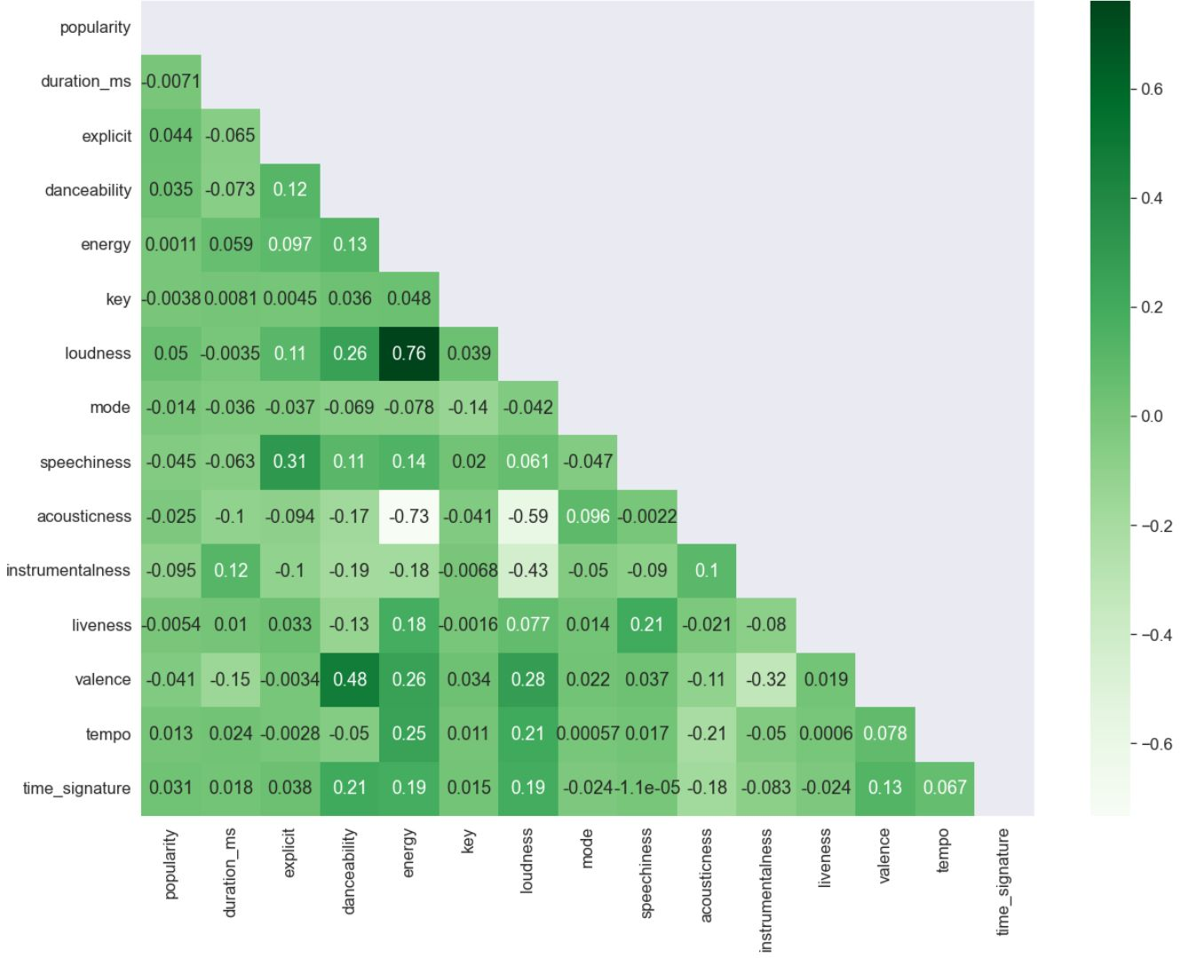
Group 2
Data Exploration: Correlations
Our Team
Agenda
Problem
Statement
Our Data
Negative correlation:
ACCOUSTICNESS and ENERGY
ACCOUSTICNESS and LOUDNESS
INSTRUMENTALNESS and LOUDNESS
Positive correlation:
LOUDNESS and ENERGY
DANCEABILITY and VALENCE
Data Exploration
Methodology
Conclusions

Slide 10
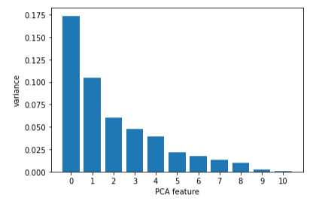
Group 2
Our Team
Data Exploration: Dimension Reduction
Agenda
Problem
Statement
Our Data
Data Exploration
Methodology
Conclusions
Bar graph showing explained variance by features for PCA. We can see a lot of unexplained variance

Slide 11
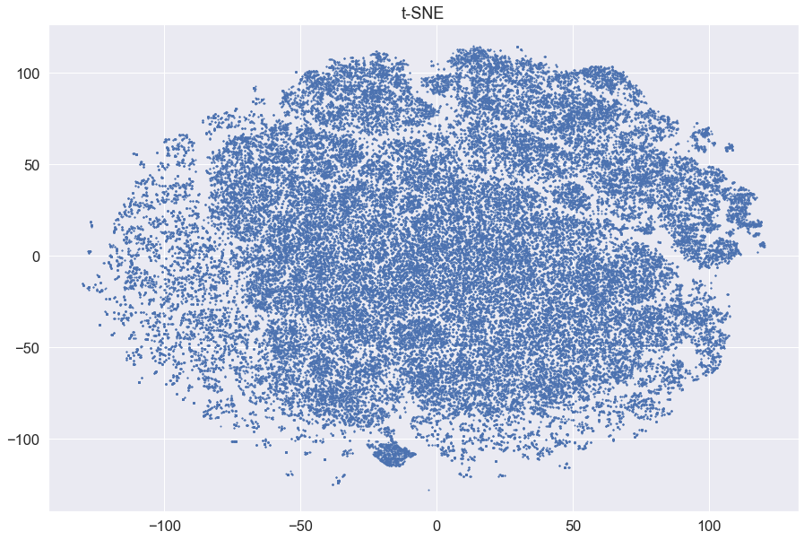
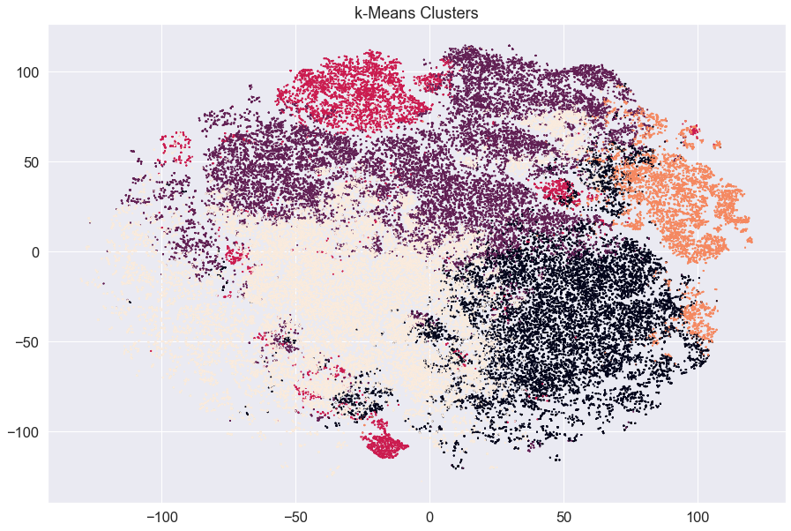
Group 2
Data Visualization: Clustering - (Exploration)
Our Team
Agenda
Problem
Statement
Our Data
Data Exploration
Methodology
Conclusions
Dimensionality Reduction using t-SNE
Clustering using k-means
The purpose is to identify patterns and similarities between the tracks based on their features, and to group them into clusters based on those similarities.
Original features are transformed into new, lower-dimensional features using t-SNE that best preserve the pairwise similarities between data points.
Each point in the plot represents a track and its position reflects its similarity to other songs in the dataset. Each track was assigned a cluster label, which represented its similarity to other songs in that cluster. The color of each point indicates the cluster that it belongs to, as assigned by the k-means algorithm
However, it can be difficult to interpret the meaning of these new features because they are often complex combinations of the original features.
NOTE: We did not make use of this analysis in our model building step

Slide 12
Group 2
Model 1-Popularity Based
Our Team
Agenda
Problem
Statement
Fixes the cold start problem
Can be used for new users that have not input a song or playlist of which they want recommendations
Gives the most popular songs based on popularity score
Can be most popular overall or by genre
Measured by given popularity column
Our Data
Data Exploration
S.No. | Artist | Track Name | Genre
1 | The Killers | Runaway Horses - Abridged | alternative
2 | Joy Division | Atmosphere | alternative
3 | No Doubt | Just A Girl | alternative
4 | Weezer | Island In The Sun | alternative
5 | Nirvana | Come As You Are | alternative
6 | The Smashing Pumpkins | Bullet With Butterfly Wings | alternative
7 | Red Hot Chili Peppers | Nerve Flip | alternative
8 | Andres Calamaro | Enganchate Conmigo | alternative
9 | Los Abuelos De La Nada | Lunes Por La Madrugada | alternative
10 | Hillsong UNITED | Oceans (Where Feet May Fail) | alternative
Methodology
Conclusions

Slide 13
Group 2
Model 1-Popularity Based
Our Team
Agenda
Problem
Statement
S.No. | Artist | Track name | Genre | Popularity
1 | Sam Smith, Kim Petras | Unholy | Dance, pop | 100
2 | Bizarrap; Quevedo | Quevado: Bzrp Music Sessions, Vol. 52 | Hip-hop | 99
3 | David Guetta; Bebe Rexha | I’m Good (Blue) | Dance, EDM, Pop | 98
4 | Manuel Turizo | La Bachata | Latin, Latino, Reggae, Reggaeton | 98
5 | Bad Bunny | Titi Me Pregunto | Latin, Latino, Reggae, Reggaeton | 97
6 | Bad Bunny, Chencho Corleone | Me Porto Bonito | Latin, Latino, Reggae, Reggaeton | 97
7 | OneRepublic | I Ain’t Worried | Piano, Pop, Rock | 96
8 | Bad Bunny | Efecto | Latin, Latino, Reggae, Reggaeton | 96
9 | Bad Bunny, Bomba Estero | Ojitos Lindos | Latin, Latino, Reggae, Reggaeton | 95
10 | Bad Bunny | Moscow Mule | Latin, Latino, Reggae, Reggeaton | 94
Our Data
Data Exploration
Methodology
Conclusions

Slide 14




Group 2
Model 2: Lyrics Based-Song Radio
Our Team
Agenda
Problem
Statement
Use Genius API to get the lyrics from our dataset
58,913 songs’ lyrics
Filtering english songs: Left with 40,745 songs
Filtering duplicate songs: Left with 35,015 songs
Our Data
Data Exploration
Data cleaning
Removing punctuations, and stopwords
Methodology
Conclusions
Building Natural Language Processing(NLP) pipeline
Lemmatize
Tokenize
CountVectorizer
Use cosine similarity to calculate the similarity of songs
Input 1 song id, will output 10 songs based on the highest similarity score

Slide 15
Group 2
Model 2: Lyrics Based-Song Radio
Our Team
Agenda
Problem
Statement
Insert:
Song ID | Track name | Artist
'01MVOl9KtVTNfFiBU9I7dc' | Days I Will Remember | Tyrone Wells
Our Data
Data Exploration
S.No. | Track name | Artist | Similarity score
1 | Domino Dancing | Pet Shop Boys | 0.6465
2 | Another Day | White Reaper | 0.6322
3 | Some Days | Brent Morgan | 0.6108
4 | Once A Day | George Jones | 0.5870
5 | The Emperor | YUNGBLUD | 0.5755
6 | Day N Night | Afrojack;Black V Neck;Muni Long | 0.5712
7 | Lonely Day | System Of A Down | 0.5637
8 | Not A Day Goes By | Leatherface | 0.5596
9 | Good Day for Living | Joe Nichols | 0.5427
10 | Wait | Martin Jensen;Loote | 0.5339
Methodology
Conclusions
Result:

Slide 16
Group 2
Model 3: Feature Based Recommendation
Our Team
Agenda
Problem
Statement
Prepare Dataset
Get Inputted Playlist Data
Find Similarity Using Distance
Output Curated Spotify Playlist
Our Data
Optionally include genre feature and/or only include English song titles
Scale numeric variables
Using Spotify API, get DataFrame of songs in playlist
Scale inputted data
Remove inputted songs from dataset
Use Gower distance to include genre for comparison
Use Euclidean distance for just similar sounding songs
Find most similar songs to each song in the playlist
Treat all inputted songs as cluster and find closest songs to centroid
Create playlist in Spotify and output playlist URL
Data Exploration
Methodology
Conclusions

Slide 17
Live Demo

Slide 18
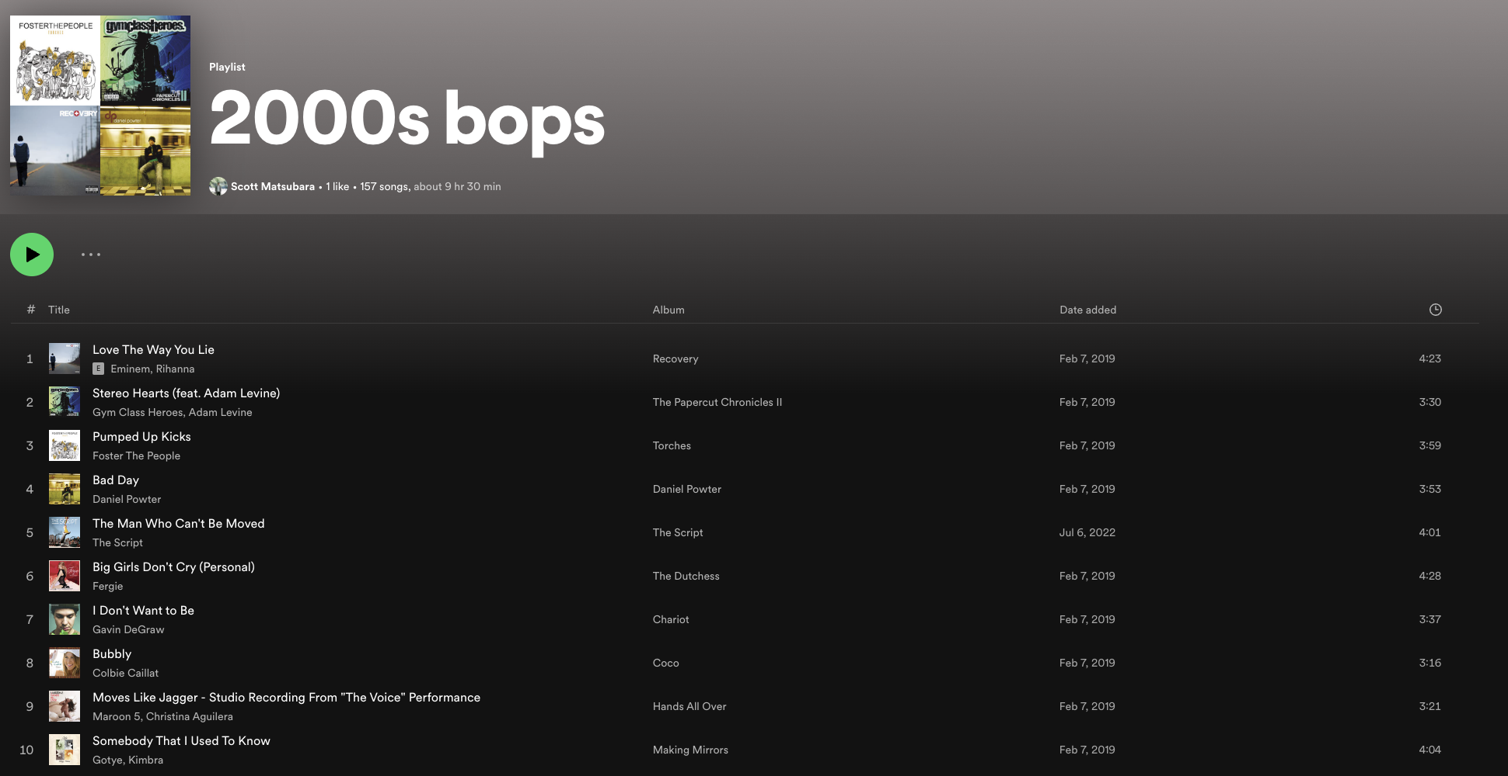
Group 2
User Created and Inputted Playlist
Our Team
Agenda
Problem
Statement
Our Data
Data Exploration
Methodology
Conclusions

Slide 19
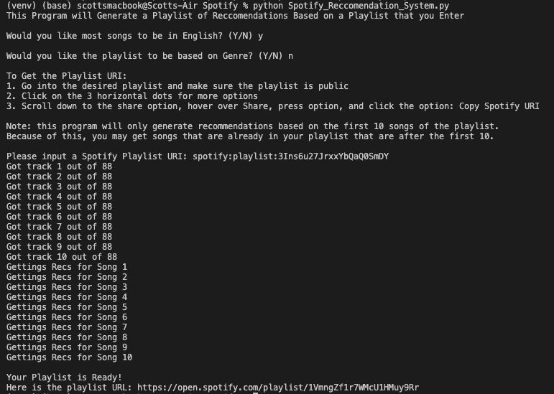
Group 2
Input and Output of Program
Our Team
Agenda
Problem
Statement
Proceessing…
Our Data
Data Exploration
Methodology
Conclusions

Slide 20
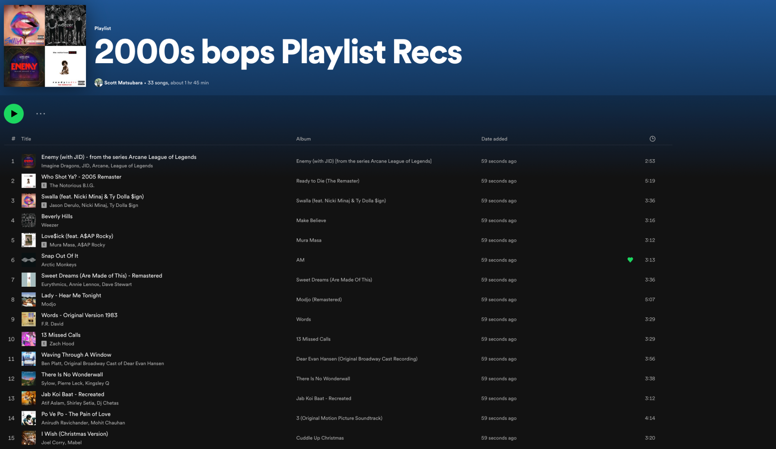
Group 2
Recommended Playlist is Generated in Spotify
Our Team
Agenda
Problem
Statement
Our Data
Data Exploration
Methodology
Conclusions

Slide 21
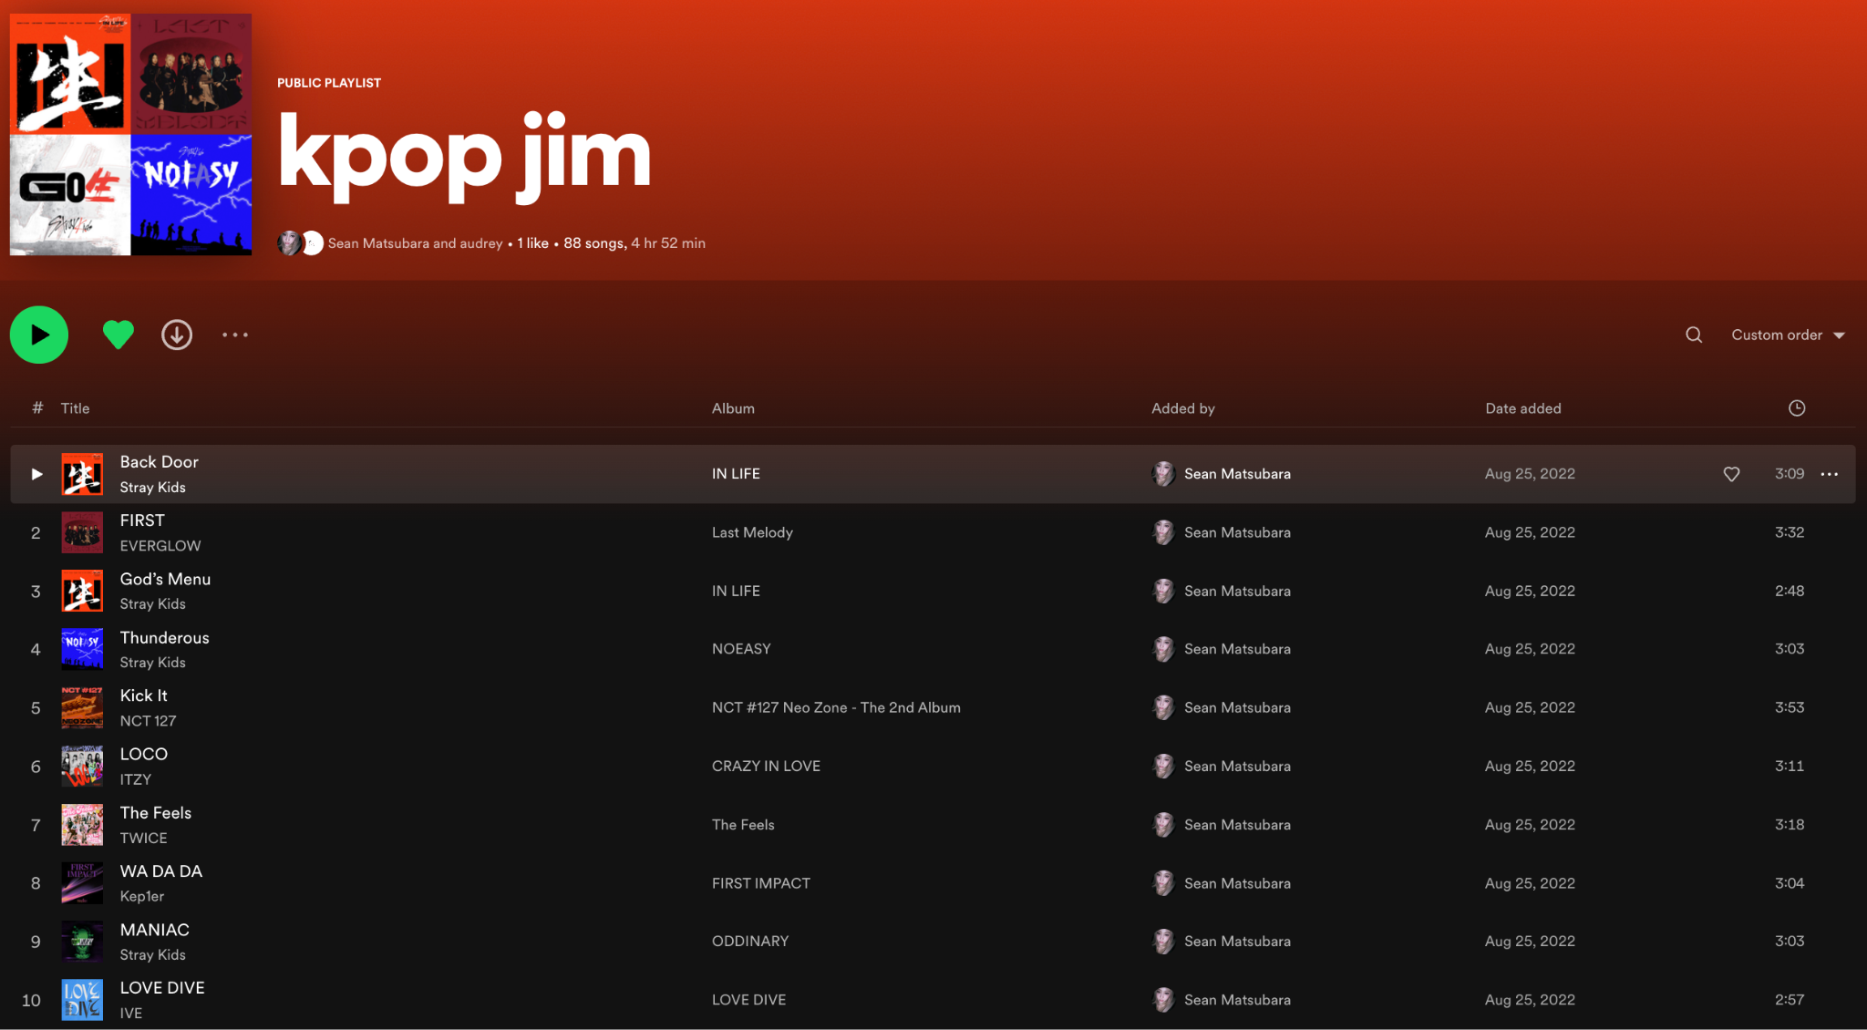
Group 2
Another Inputted Playlist
Our Team
Agenda
Problem
Statement
Our Data
Data Exploration
Methodology
Conclusions

Slide 22
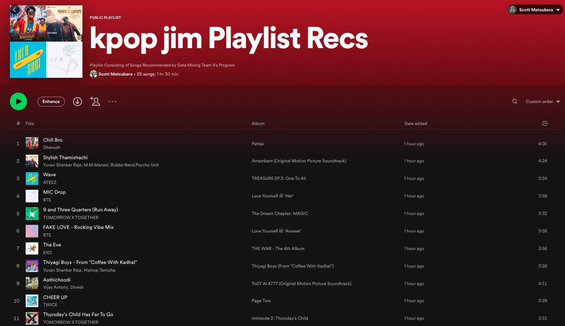
Group 2
Playlist Generated Using Gower Distance
Our Team
Agenda
Problem
Statement
Our Data
Data Exploration
Methodology
Conclusions

Slide 23
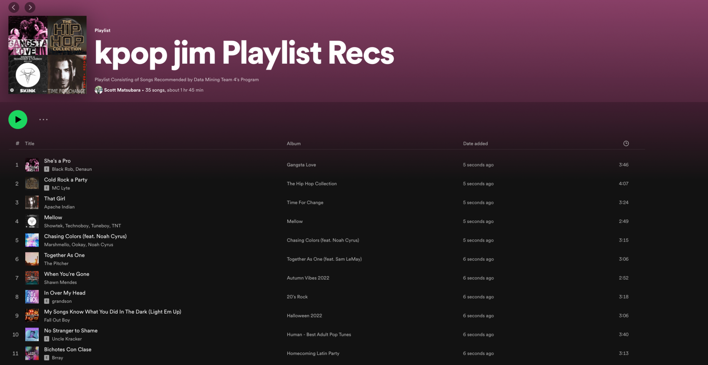
Group 2
Playlist Generated Using Euclidean Distance
Our Team
Agenda
Problem
Statement
Our Data
Data Exploration
Methodology
Conclusions

Slide 24
Group 2
Conclusions
Our Team
Agenda
Problem
Statement
Our Data
Recommendations:
Popularity based: for new users that don’t have listening history
Lyrics based: when people are listening to one song, we can recommend others with a similar theme
Features based: will recommend a new playlist, based on your current one
Data Exploration
Methodology
Conclusions

Slide 25
Group 2
Our Recommendation Systems Value Add
Our Team
Agenda
Problem
Statement
Increase User Retention: Spotify can keep users engaged and coming back to the platform in order to build loyal user base
Improved User Satisfaction: This can lead to more positive brand image
Increased Revenue: If more users are on platform that can lead to increased revenue through advertising and subscription fees.
Competitive Advantage: By offering personalized recommendations that other platforms cannot match, Spotify can maintain a competitive advantage and attract new users.
Switching Cost: Because of our recommendation systems, more users may become attached to the platform, making it more difficult for the users to switch to another music platform. This can increase switching costs for users, as they may have to start from scratch with a new platform and build up their preferences.
Our Data
Data Exploration
Methodology
Conclusions

Slide 26


Group 2
Future Improvements
Our Team
Agenda
Problem
Statement
Add more songs and genres
User ratings dataset
Days based recommendations
Combine different models to a full scale end product
Create a UI
Our Data
Data Exploration
Methodology
Conclusions

Slide 27



Thank You!
Any Questions?
Closing Time
Semisonic
0:23
-4:34

Slide 28
Appendix
Closing Time
Semisonic
0:23
-4:34

Slide 29
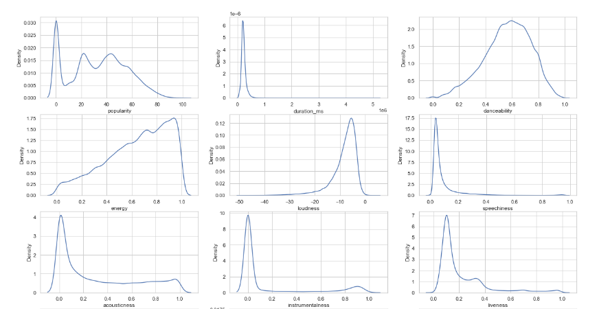
Group 2
Data Exploration: KDE
Our Team
Agenda
Problem
Statement
Our Data
Data Exploration
Methodology
Conclusions
KDE Plots for All Numeric Features

Slide 30
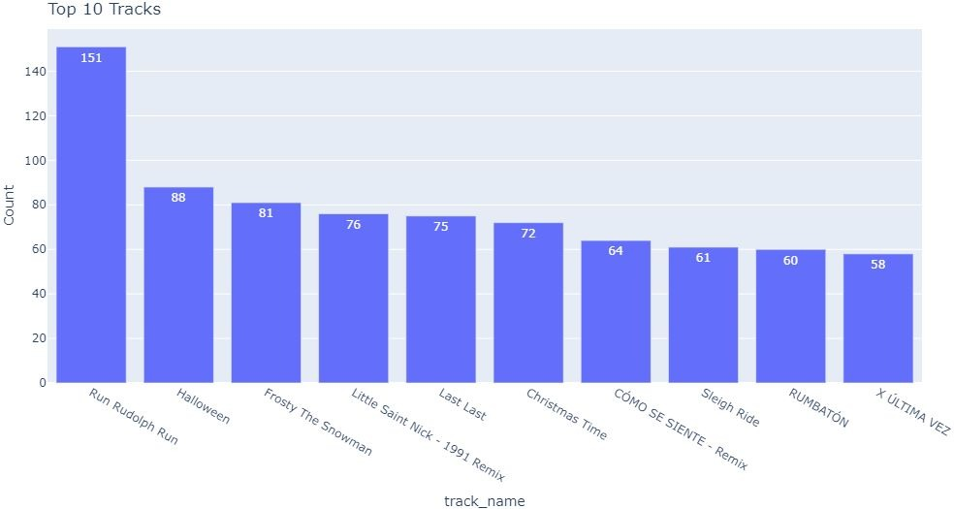
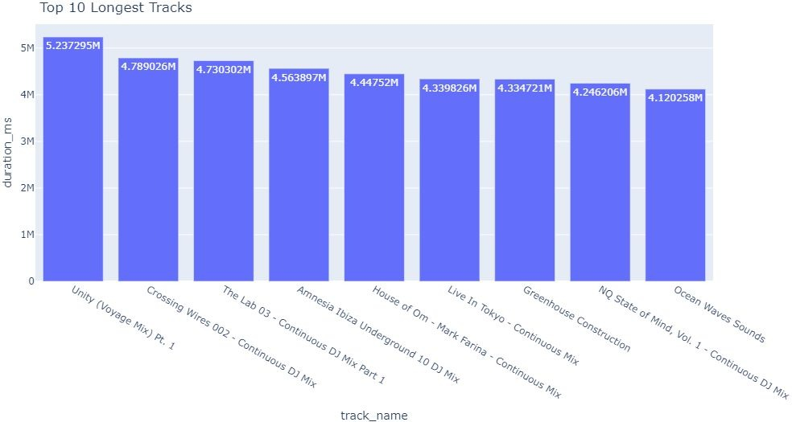
Group 2
Data Exploration
Our Team
Agenda
Problem
Statement
Our Data
Data Exploration
Methodology
Conclusions
Top 10 most common tracks
Top 10 tracks with the longest duration

Slide 31
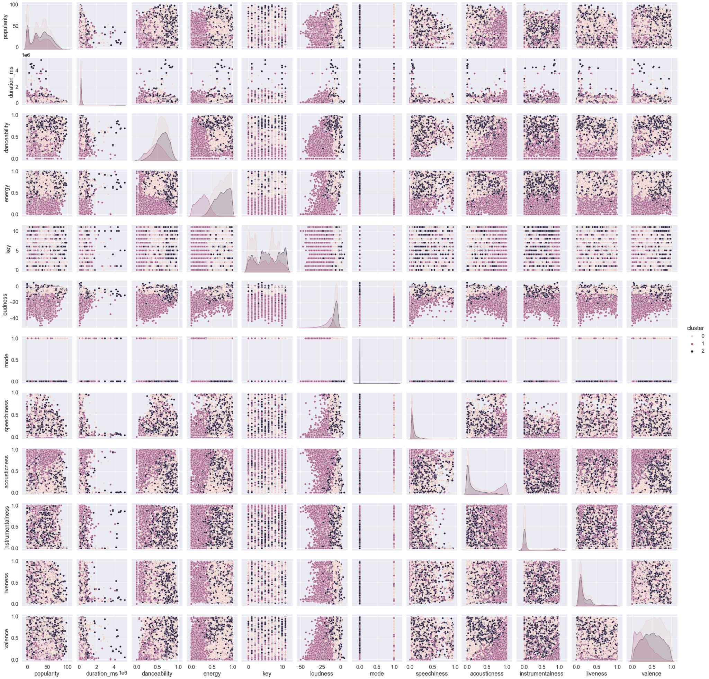
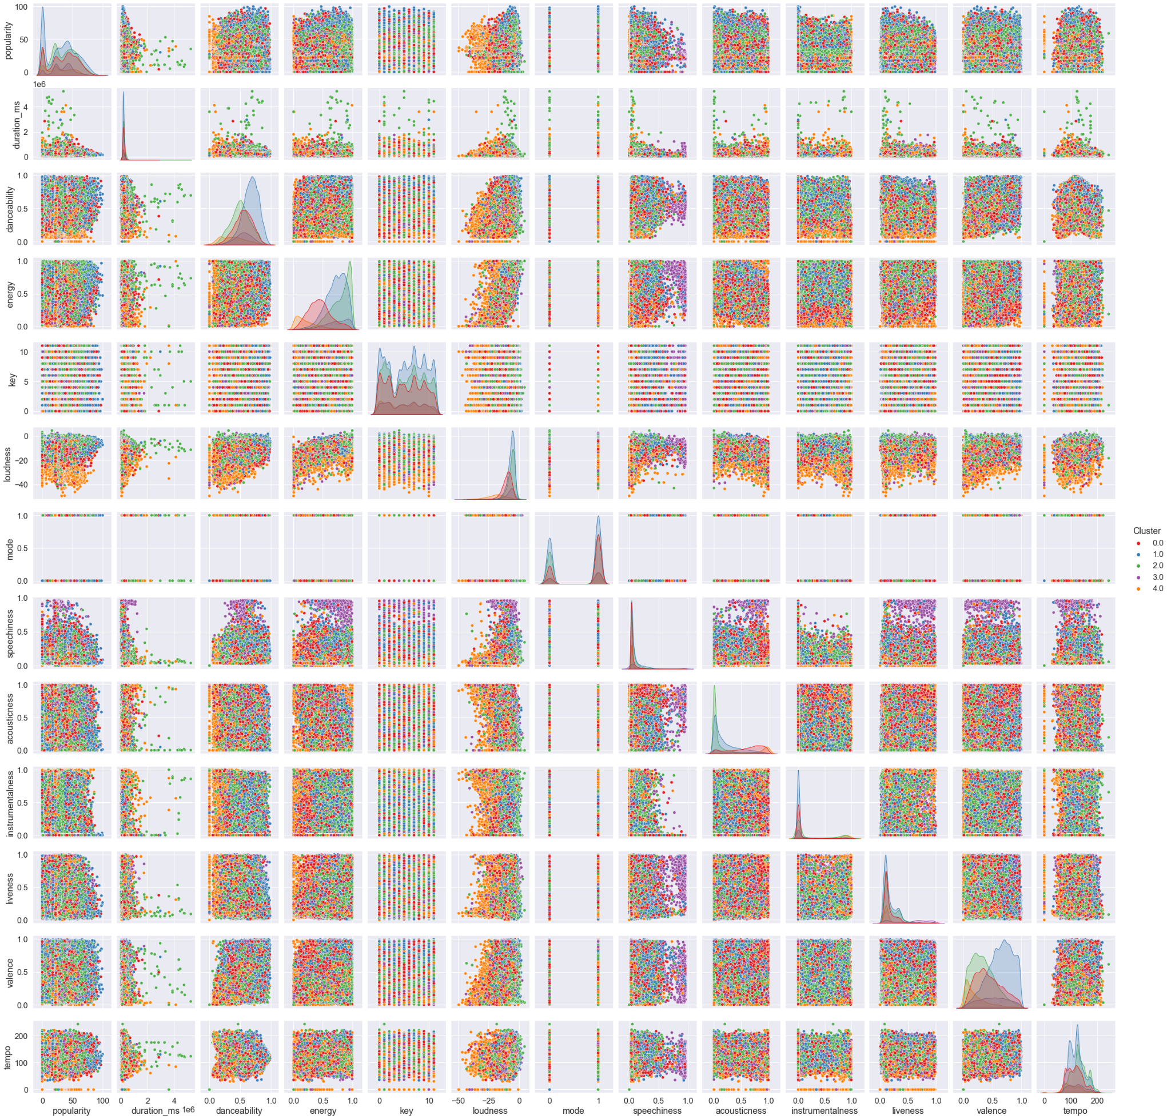
Group 2
Data Visualization: Clustering
Our Team
Agenda
Problem
Statement
Our Data
Data Exploration
Methodology
Conclusions
Clustering using k-means (3 and 5 clusters)

Slide 32
Group 2
Our Data
Our Team
Agenda
Problem
Statement
Our Data
Dataset.csv (Observations: 89741 and Variables: 22)
The basic information of the song:
String:
o track_id, artists, album_name, track_name
The traits of the song:
Numerical data which is calculated by Spotify algorithm:
o popularity(0-100), danceability(0-1), energy(0-1), speechiness(0-1), acousticness(0-1), instrumentalness(0-1), liveness(0-1), valence(0-1)
Numerical data:
o duration_ms, loudness, tempo, time_signature
Categorical:
o explicit, key, mode, track_genre
The lyrics of the song:
String
Data Exploration
Methodology
Conclusions

